Slide 1
Overskrift
Proceedy
Your digital assistant

Slide 2
It´s a challenge allways to be on top
Pains for lawyers:
Creating overview of the case
Extract the most important information from documents in the case and save it (persons, themes, organizations and places)
Stress over deadlines
Going back and forth between many cases
Work together on large cases is difficult

Slide 3
Facts from our findings
Lawyers work with up to 400 cases at a time
Average time for a case going through the legal system in Denmark is 22 months
+800.000 cases go to court in Denmark every year
Only 1/10 of all cases go to court
Most lawyers have 1 or more people to assist printing, scanning, producing timelines or other practical work around the case/client.
“If a case has more than 10.000 pages we need to print it to get a good overview”

Slide 4
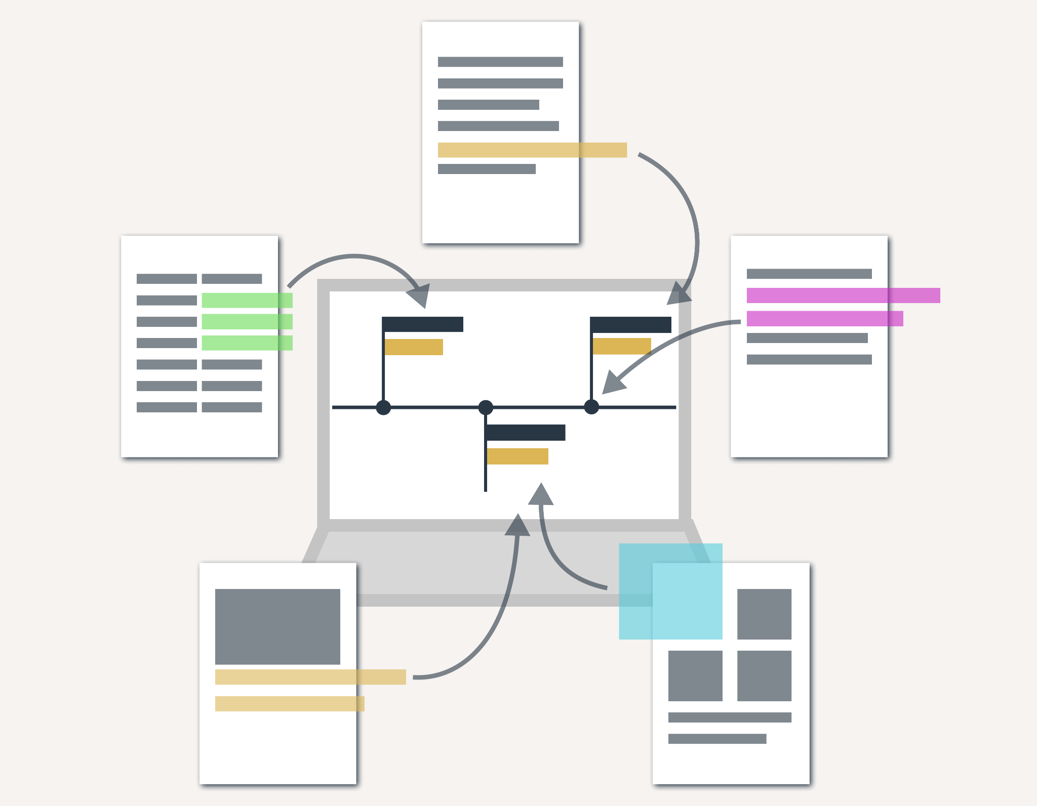
Proceedy Timeline - our first product
A simple tool for a complex task
Easy access to your digital overview
Connect your findings to the timeline and make a theme and save it for later
Keep track of the important points
Share information with colleagues and clients
Get a smooth and professional timeline

Slide 5
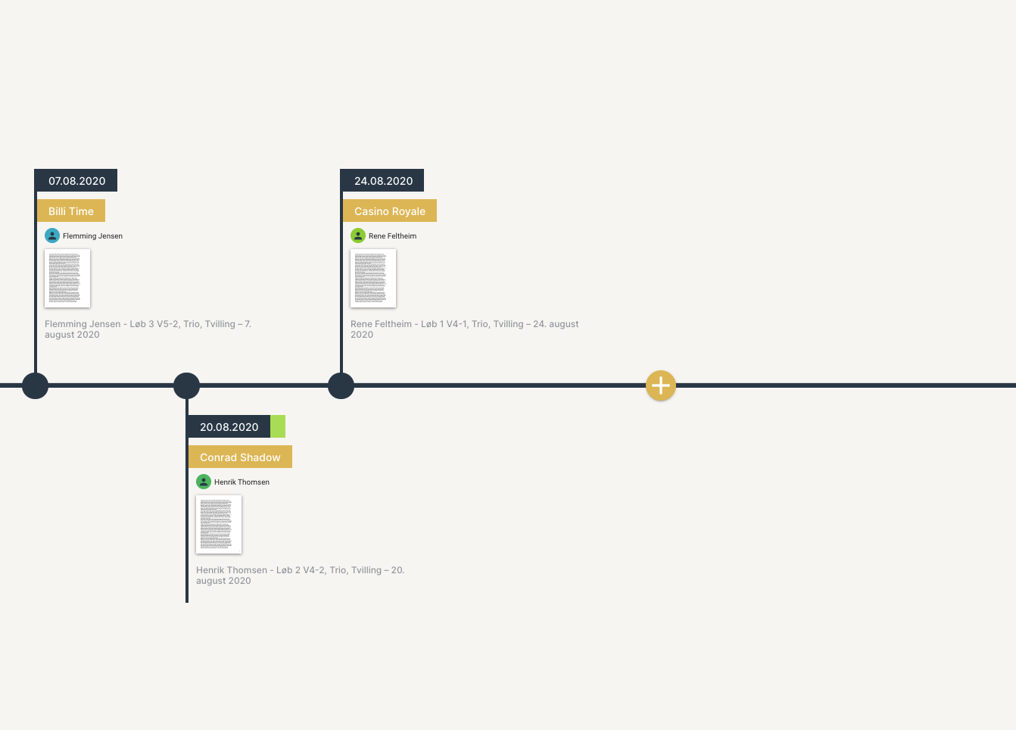
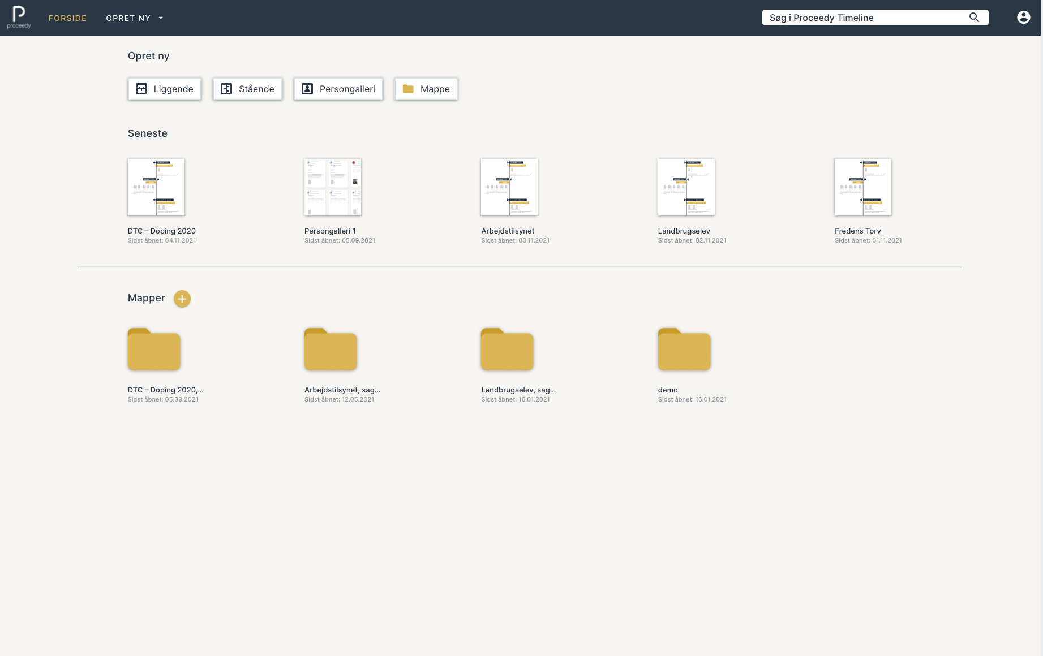
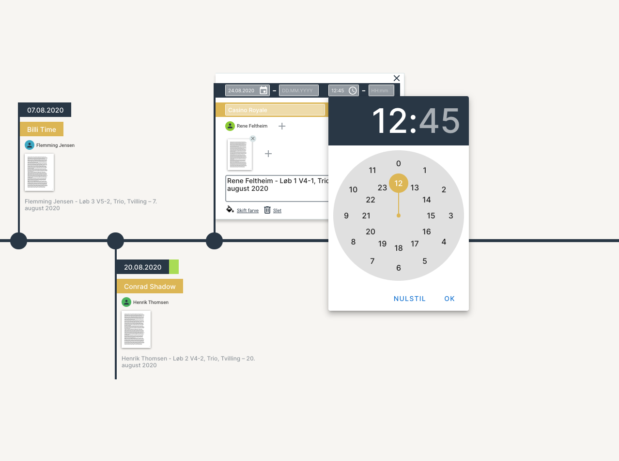
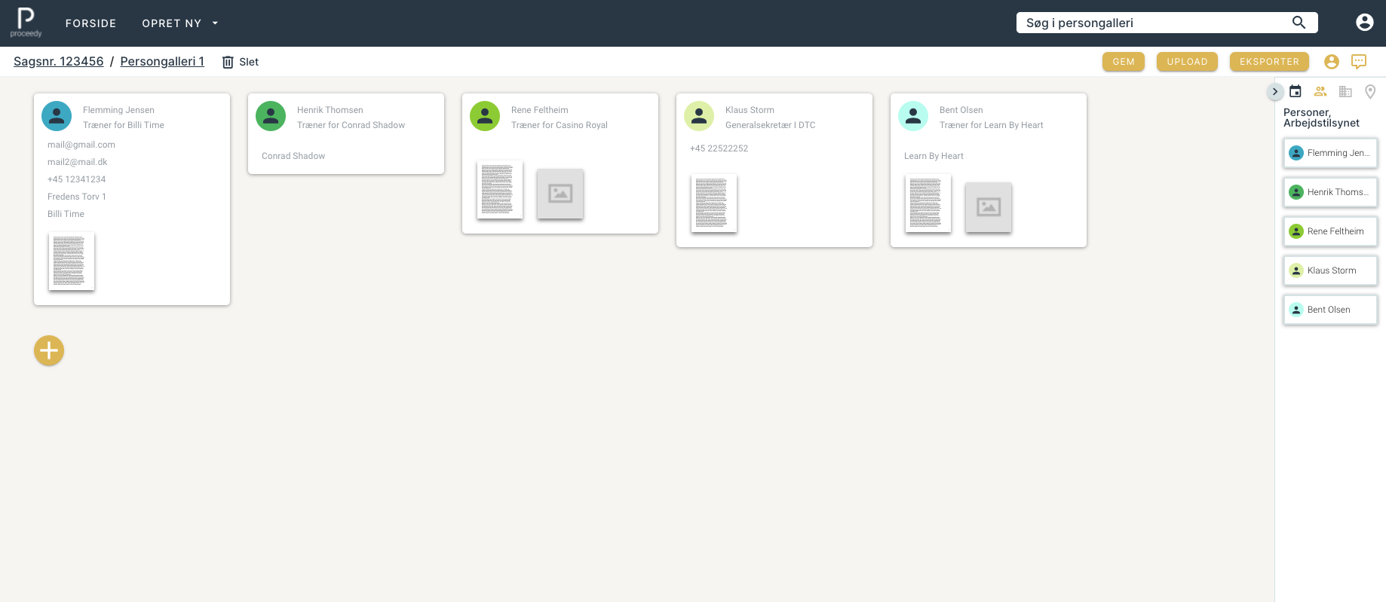
Proceedy Timeline

Slide 6
Market 2022/23
We will start our journey in Denmark and Norway where we already have the first 4-5 beachhead customers and partners in the pipeline.
Lawyers and legal professionals in Denmark and Norway (+ 20.000 users)
Legal counsellors in organisations in Denmark and Norway(+ 20.000 users)
But our future market is the world...

Slide 7
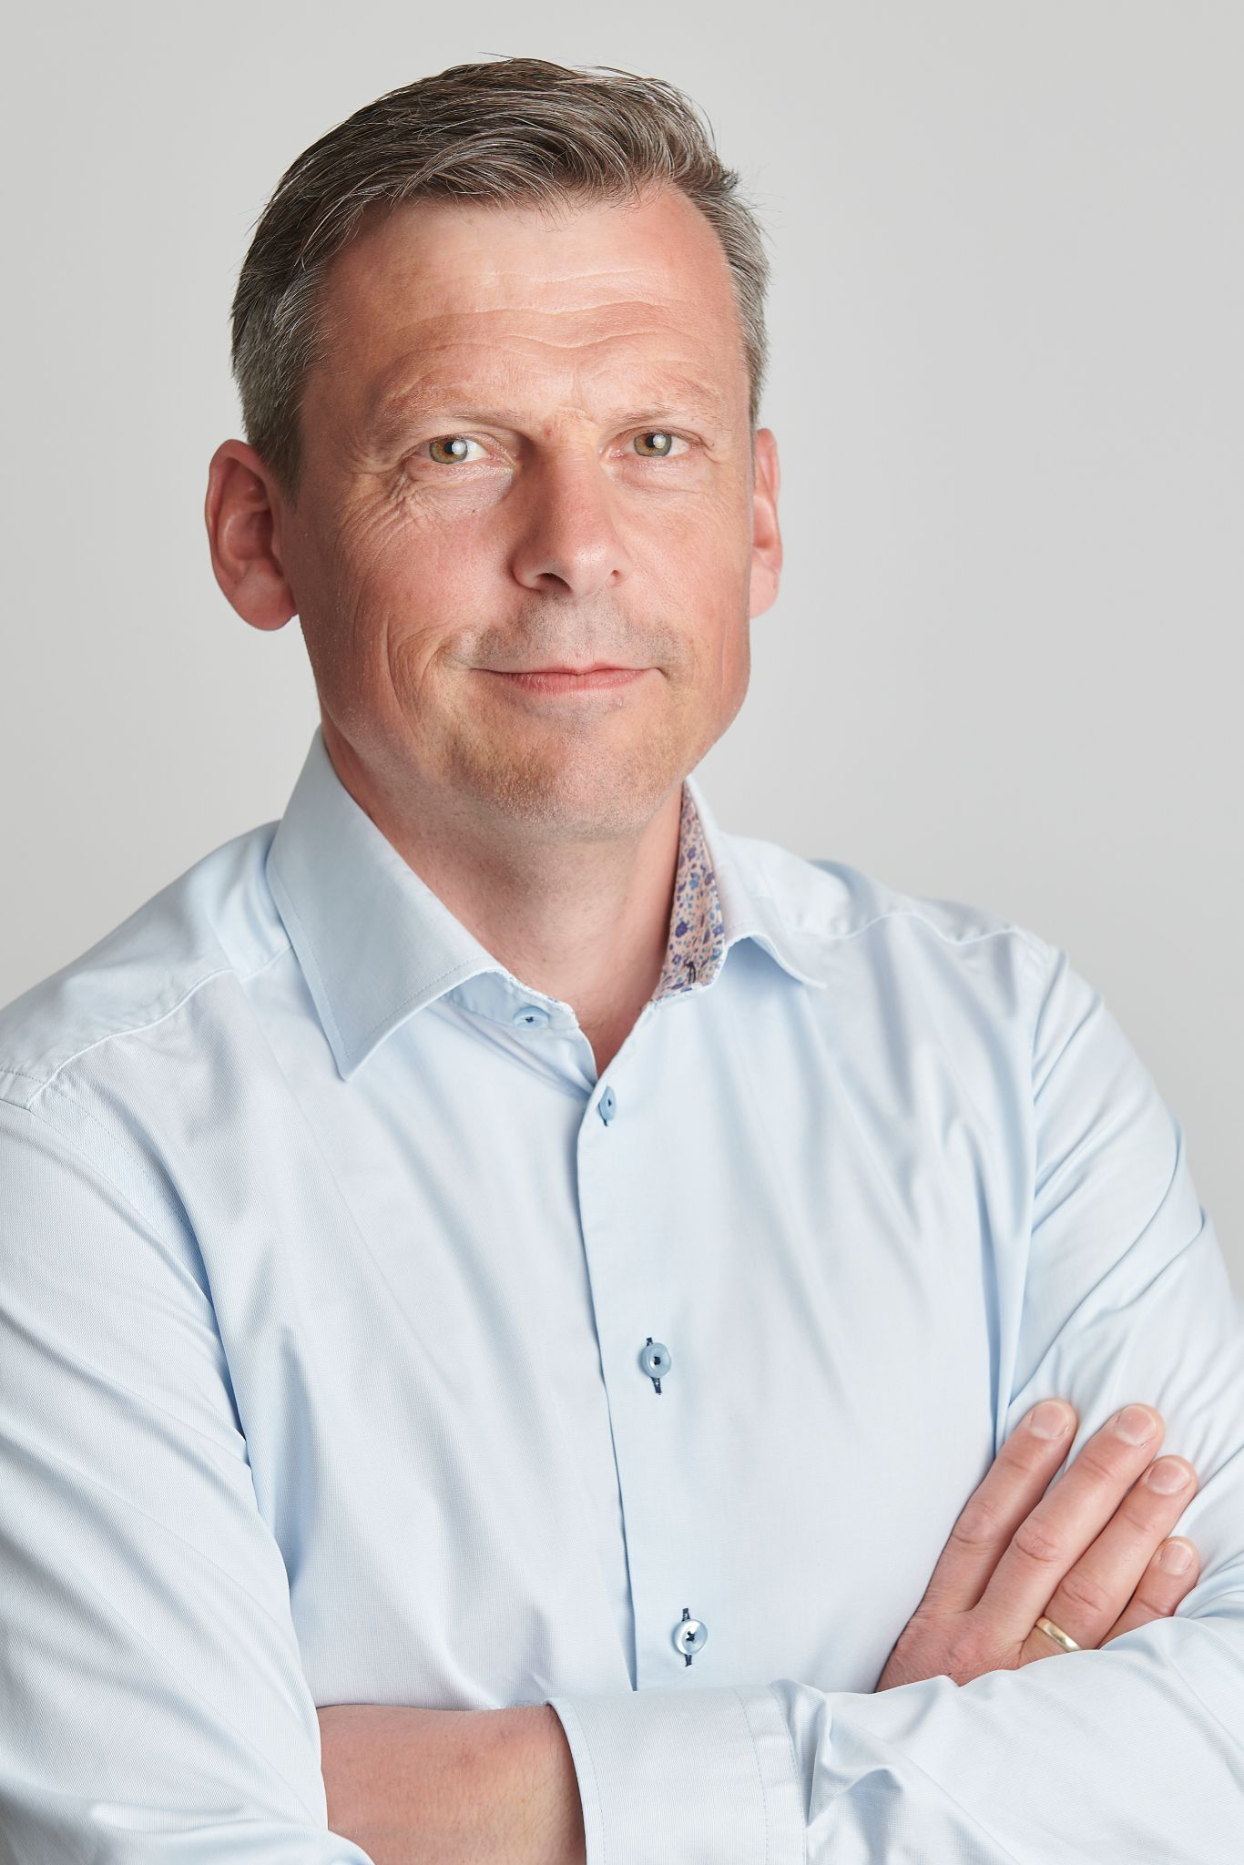
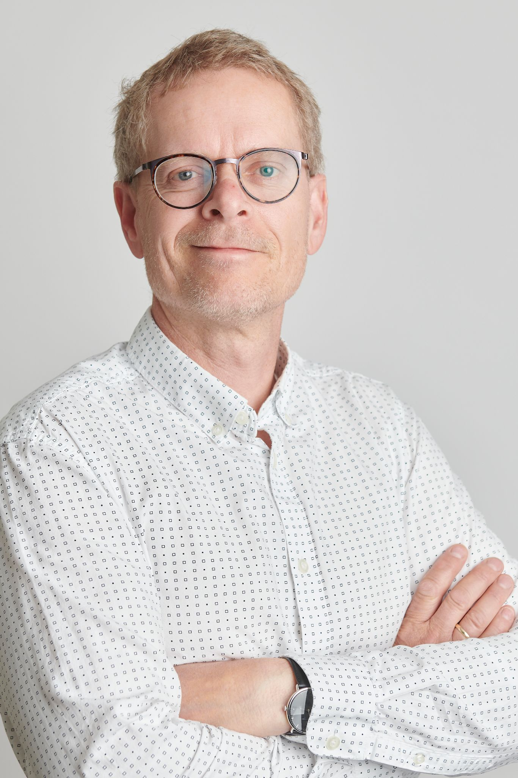
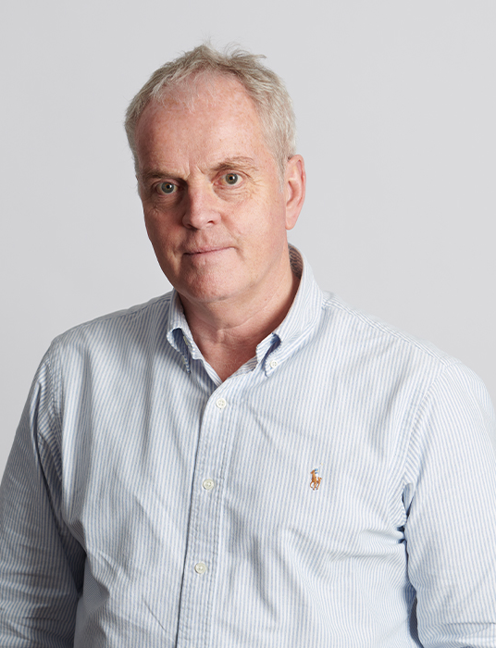
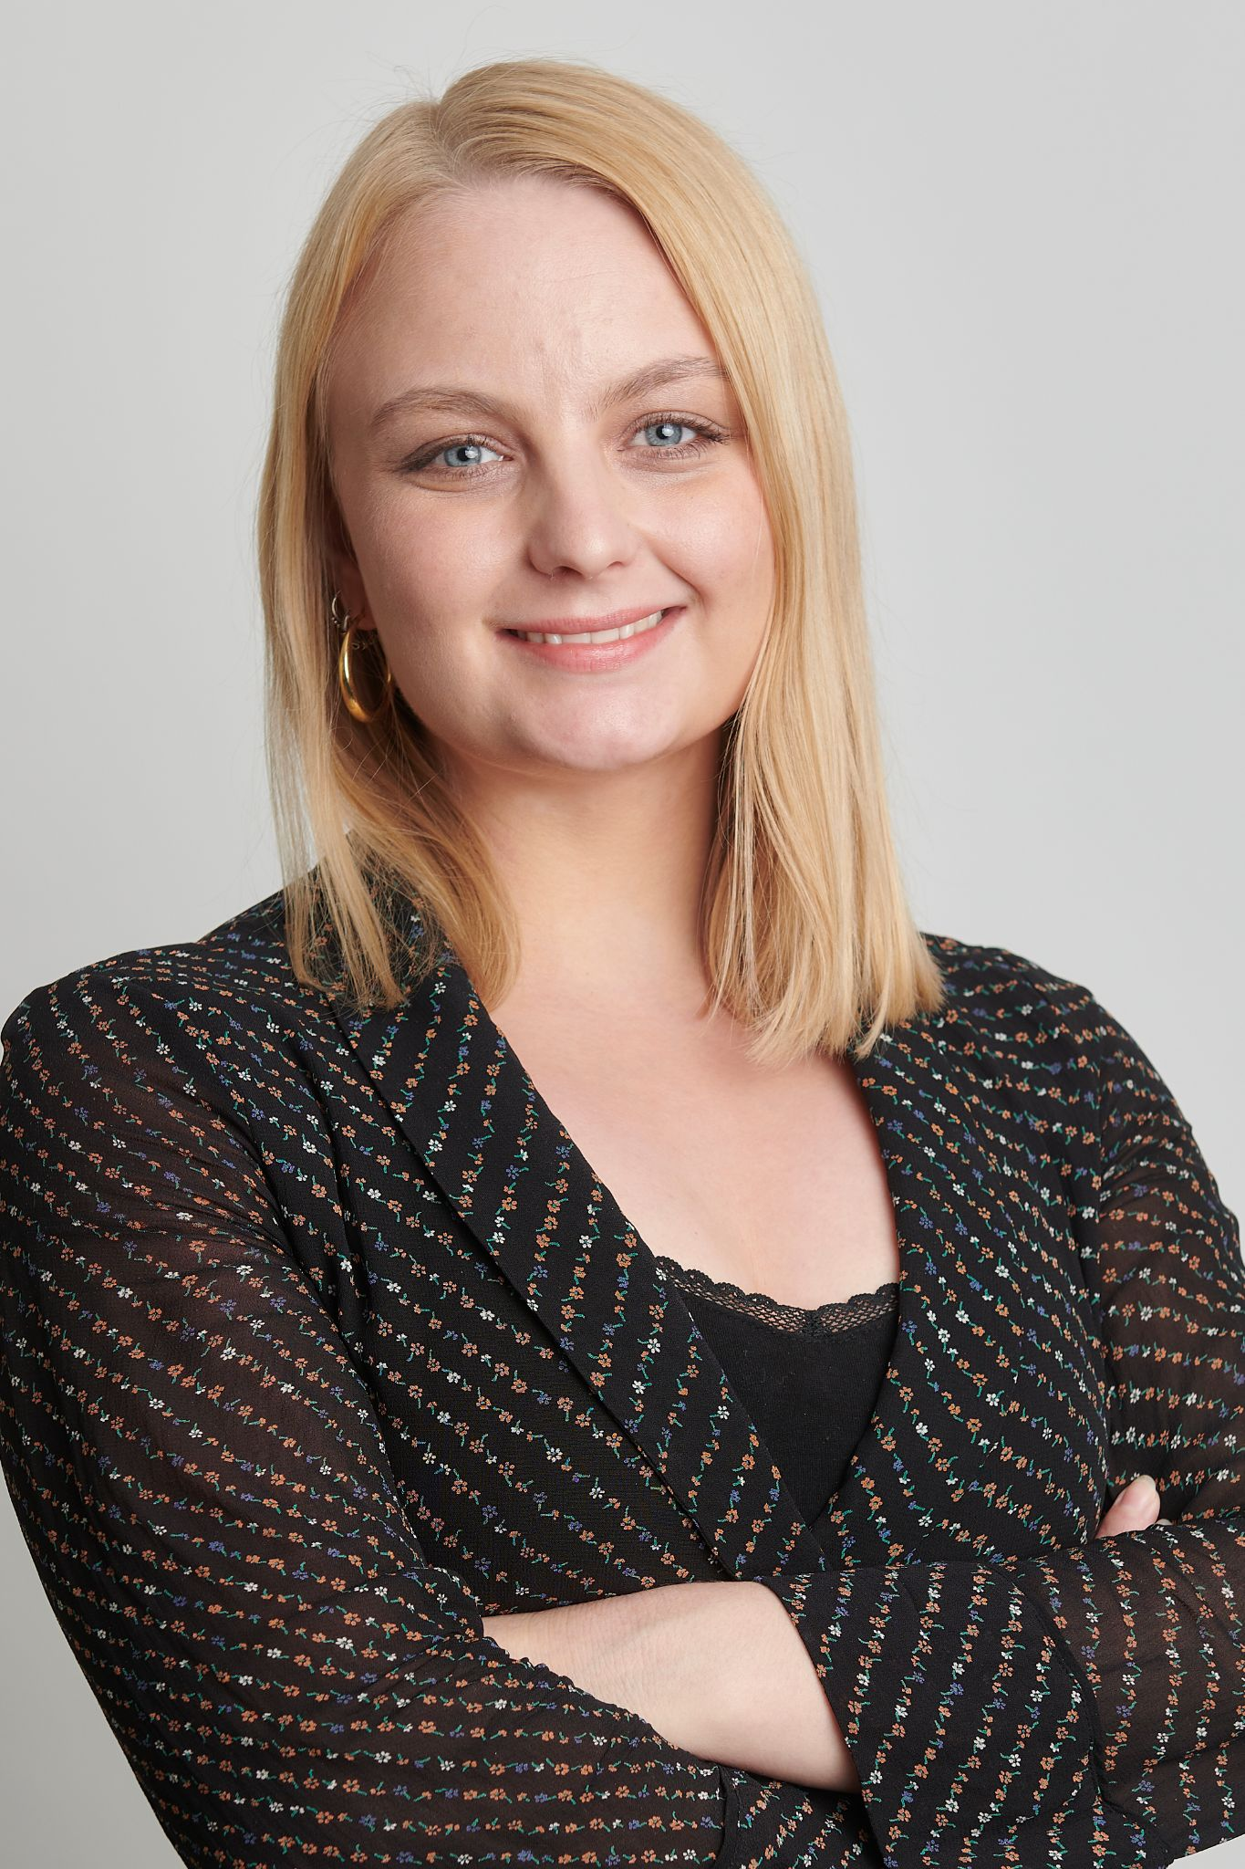
The Team
CEO - Anders Juul (founder)
10 years working with SaaS (FirstAgenda)
CTO - Aage Nielsen (founder)
+20 years developing software to the financial sector
CFO - Leif Krowicki
+30 years with accounting
Product Owner -
Eva Konrad Hanneslund
Master of Information Science

Slide 8
Mission
Proceedy will be the preferred digital tool for lawyers and legal professionals
- Anders Juul

Slide 9
Go to market strategy
Lawyers and Legal professionals
Inbound marketing (Linkedin, direct mail, content marketing, marketing automation)
Sales Reps
Attending Legal Tech events (Tech-tarium, Nordic Legal Tech Days etc.)
Sales via Legal Tech partners

Slide 10
Prices
Proceedy Timeline must be available to all lawyers in the world
Proceedy Standard 39$ per user per month | Proceedy Pro 49$ per user per month | Proceedy Enterprise 69$ per user per month
Create timelines Create notes and underline text Share with colleagues and clients Print timelines Online access to timelines Free support | Upload documents Offline access to your timelines Automatically created timelines via AI Search in documents Make a gallery of characters · Create themes Incl. all features from Proceedy standard | Integration to Active Directory Company logo Access to Proceedy API Access to AI functionality Incl. all features from Proceedy standard and Proceedy Pro

Slide 11
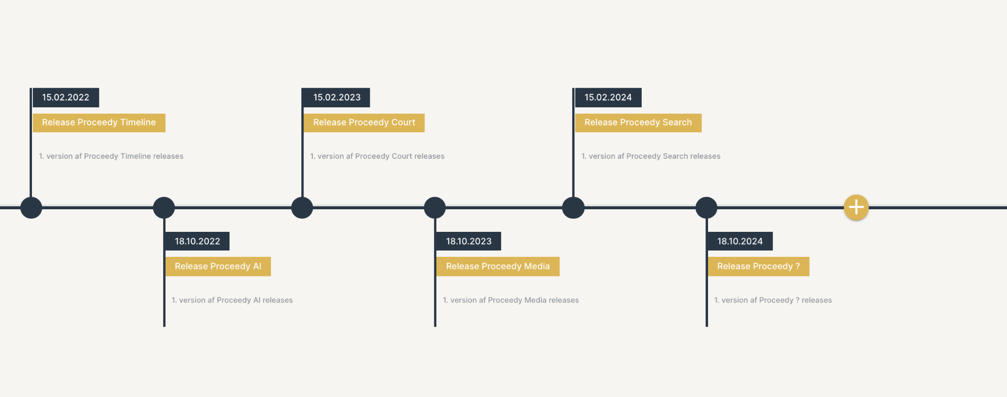
Proceedy 2024

Slide 12
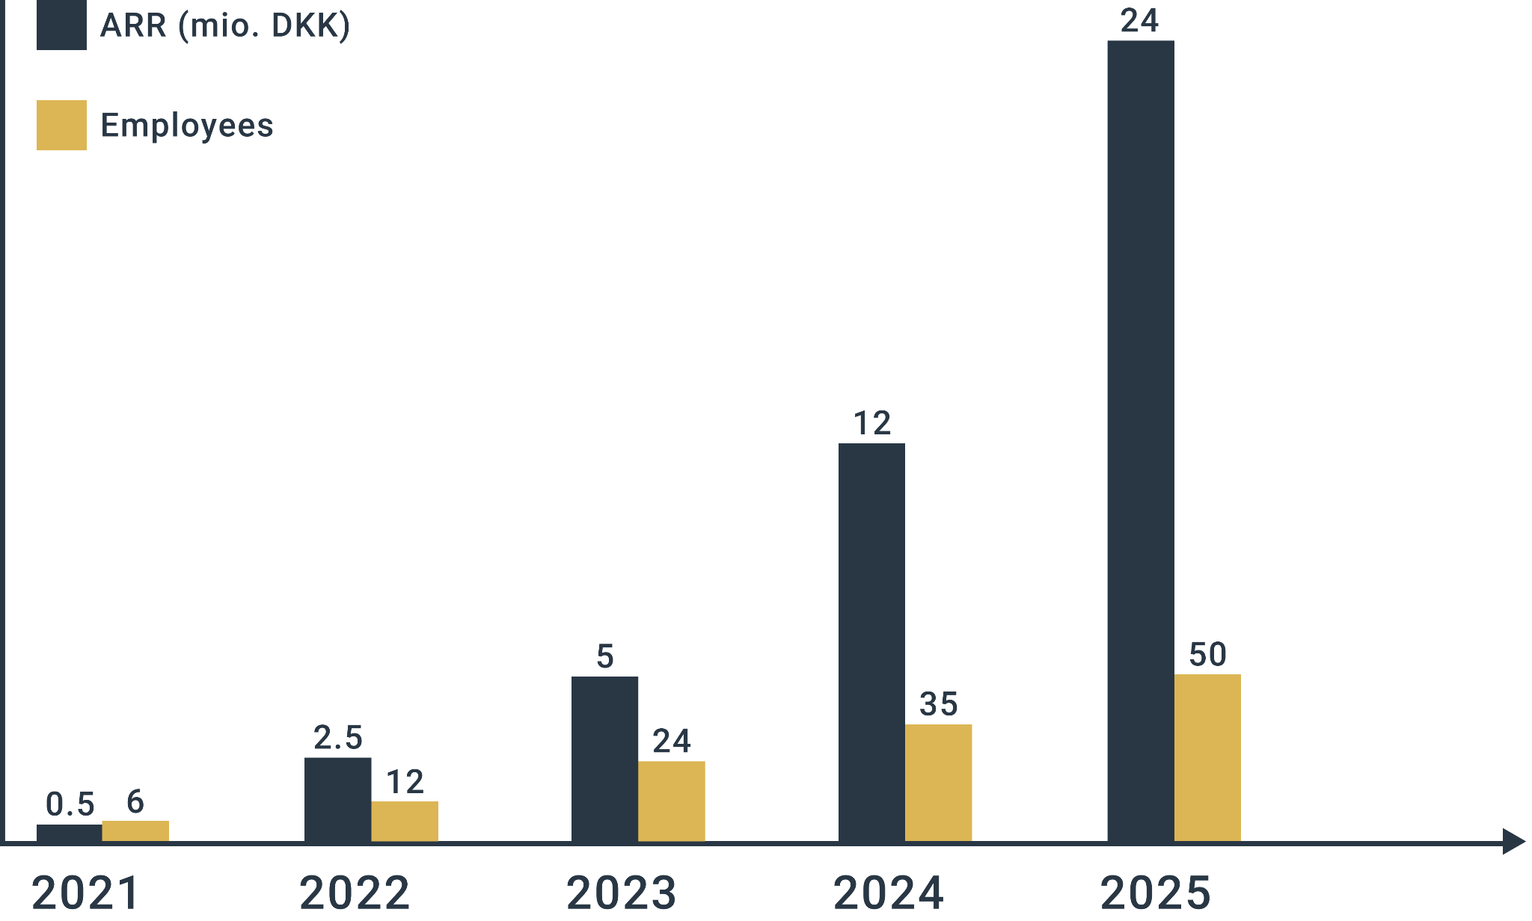
Growth plan 2021-2025

Slide 13
Our target investment is € 1.1 mio.
We plan to make these hires in the next 3-6 months
Software developer (2-3)
Establish a development team in Eastern Europe
Customer success manager
UX designer
Sales rep (1-2)
Marketing Manager
Support Manager

Slide 14
Contact information
Anders Juul +45 5193 0069 anders.juul@proceedy.dk
Aage Nielsen +45 5390 1639 aage.nielsen@proceedy.dk
Adresse: Fredens Torv 1 2. th, 8000 Aarhus C
Web: www.proceedy.dk
LinkedIn https://www.linkedin.com/company/72676027

